Slide 1
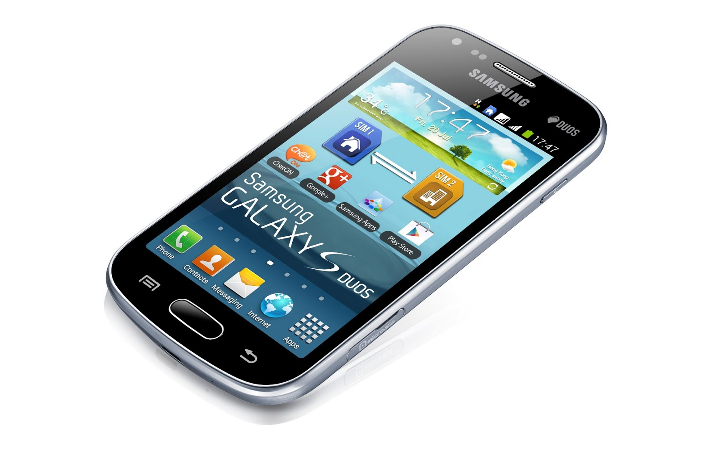
Android Mobile Development
Instructor: NGUYEN ANH MINH (M. Sc.)

Slide 2
Module 01
What is Android?
Type of Android devices
Android versions
Android Studio
Setting up Android project

Slide 3
What is Android?

Slide 4
What is Android?
●
●
Android is world’s leading mobile operating system
Google:
●
●
●
Owns Android, maintains it, extends it
Distributes Android OS, developer tools, free to use
Runs Android app market

Slide 5
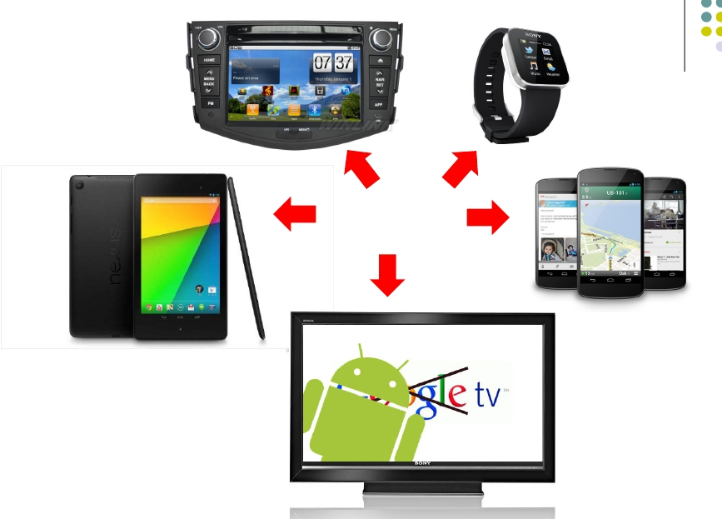
Android is Multi‐Platform
Smartwatch
In-car
console
Android runs on
all these devices
Smartphone
Tablet
Television
This Class: Focuses
Mostly on Smartphones!

Slide 6
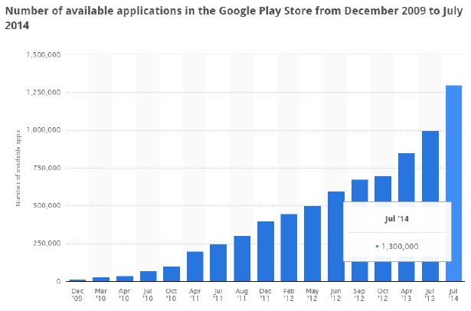
Android Growth
June 2014, 1 billion active Android users
1.25 million apps on the Android app market
●
●
●
Games, organizers, banking, entertainment, etc

Slide 7
Type of Android devices

Slide 8
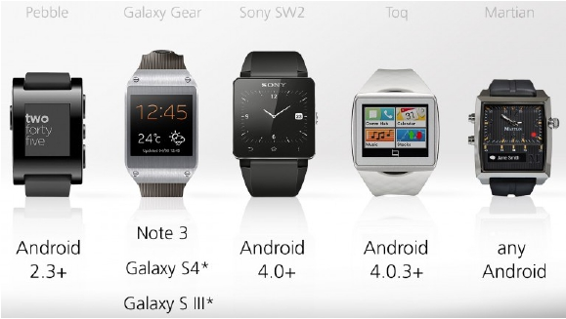
Android Wearables: Smartwatches
Minimal UI, at‐a‐glance
Mostly notifications, Not
full functionality
●
●
●
●
●
●
●
Voice Commands,
phone calls
Directions, texts, run
apps
Heart Rate monitor
Count Steps
Wireless charging

Slide 9
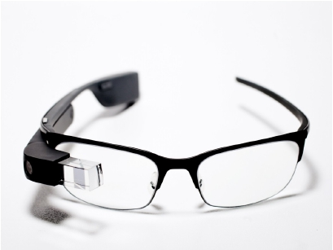
Android Wearables: Google Glass
Head‐mounted display, displays information, touch‐free
Example application: Records babies life steps
Features:
●
●
●
●
Touchpad (on side), camera for photoes video, display, voice commands
●
Google recently announced discontinuing Google Glass

Slide 10
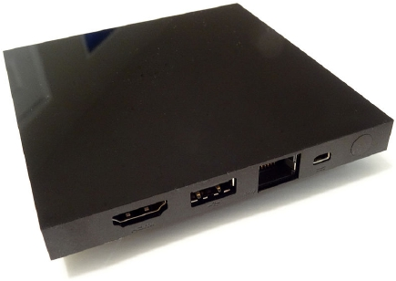
Android Hardware: TV programming
Smart, interactive TV platform (Android 5.0) featuring:
●
●
●
●
●
Viewing recommendations based on watching habits
Media apps downloadable from Google Play. E.g. Netflix streaming app
Games
Voice Search to answer questions. E.g. which movies were nominated
for academy awards

Slide 11
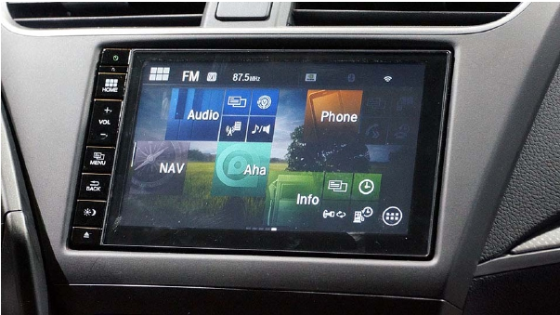
Android Hardware: in‐Car Entertainment
and Navigation System
●
●
●
●
Example: Honda Connect system
Integrated audio, phone, navigation, information system
Runs Android 4.0.4
Android Auto announced by automotive alliance in Jan 2014

Slide 12
Android versions

Slide 13
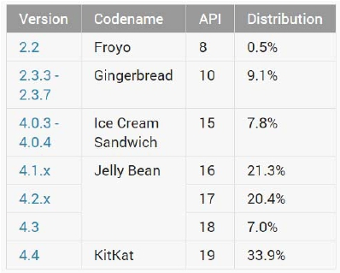
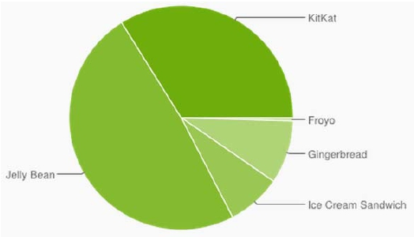
Android Versions
●
●
Most recent Android version is Android L (5.0) or “Lollipop”
Distribution as at Dec 1, 2014

Slide 14
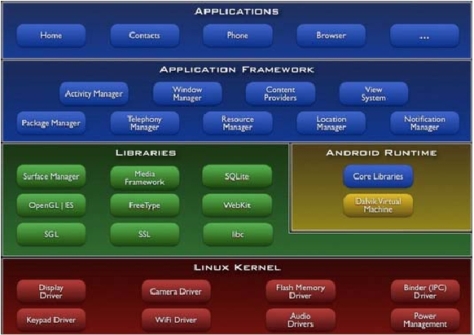
Android Software Framework
●
●
●
Android OS has Linux kernel, drivers
Android Applications: Programmed in Java
Android Libraries: OpenGL ES (graphics), SQLite (database), etc

Slide 15
Android Studio

Slide 16
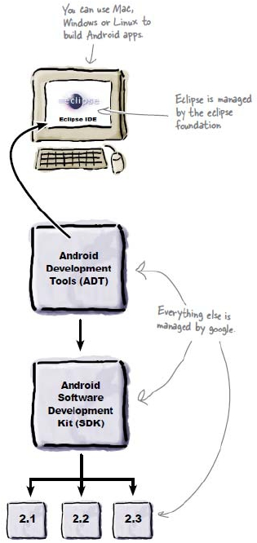
Old Developer
Android Environment
●
●
●
●
Eclipse IDE: type code in, compile,
not Android‐specific
Android Dev Tools (ADT): Eclipse
plugin, adds Android functionality
Android Software Dev Kit (SDK):
Tools to build, test and run apps
Packages: Enables developing for
various Android versions

Slide 17
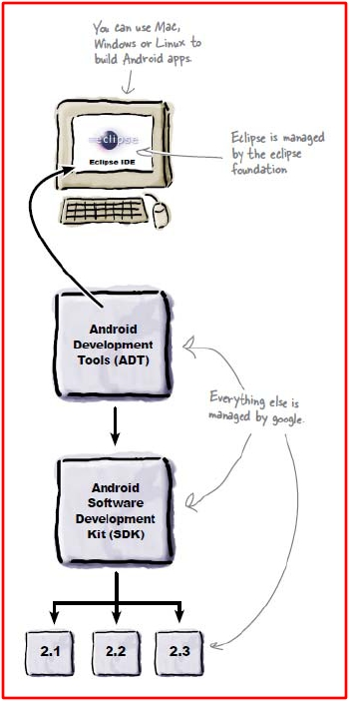

New Developer
Android Environment
●
●
●
●
Google developed it’s own IDE called
Android Studio
Combines tools in old development
environment into 1
Cleaner interface specifically for Android
Development (e.g. drag and drop app
design)
In December 2014, Google announced it
will stop supporting Eclipse IDE
Android Studio

Slide 18
Installing Android Studio
●
Step 1: Install Java (at least version 1.7)
●
Note: You may already have Java installed. Check first
●
Step 2: Set JAVA_HOME system variable
●
This variable tells applications that need Java where it is installed
●
●
Step 3: Install Android Studio (version 1.1 is the latest)
Bucky Roberts (thenewboston): nice youtube Android tutorials
●
●
Tutorial 1: Install Java [ Watch it ]
Tutorial 2: Install Android Studio [ Watch it ]

Slide 19
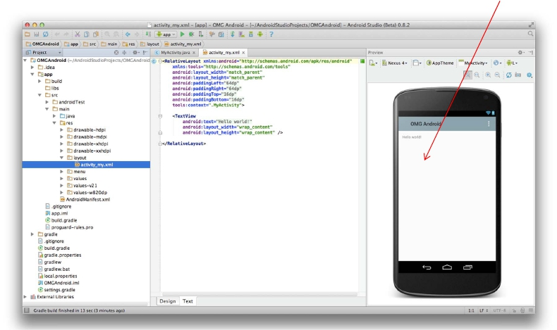
Where to Run Android App
●
Android app can run on:
●
●
Real phone (or device)
Emulator (software version of phone)
Emulated phone
in Android Studio

Slide 20
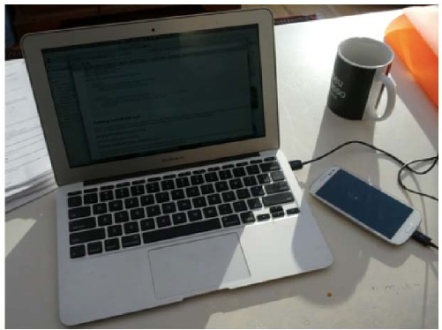
Running Android App on Real Phone
●
Need USB cord to copy app over from development PC to
phone

Slide 21
Emulator Pros and Cons
●
Pros:
●
●
Conveniently test app on basic hardware by clicking in software
Easy to test app on various devices (phones, tablets, TVs, etc), various
screen sizes
●
Cons:
●
●
Some hardware missing, especially hardware for sensing environment
E.g. GPS, camera, video recording, etc

Slide 22
Emulator Limitations
●
No support for placing or receiving actual phone calls
●
Simulate phone calls (placed and received) through the
emulator console
●
●
●
●
●
●
●
●
No support for USB connections
No support for camera/video capture (input)
No support for device‐attached headphones
No support for determining connected state
No support for determining battery charge level and AC
charging state
No support for determining SD card insert/eject
No support for Bluetooth
No support for simulating the accelerometer
●
Use OpenIntents’s Sensor Simulator
●
Slow!!!

Slide 23
Setting up Android project

Slide 24
Setting up your Project
●
●
After installing Android Studio, need to set up your project
Tutorial: Android App Development for Beginners ‐ 3
– Setting up your project by Bucky Roberts (thenewboston)
●
https://www.youtube.com/watch?v=r4oIez0sfvY
●
Main steps to set up Android Project
●
●
●
●
Start a new Android Project
Configure new Android Project (select app name, domain name, etc)
Set platform and minimum SDK
Add an Activity

Slide 25
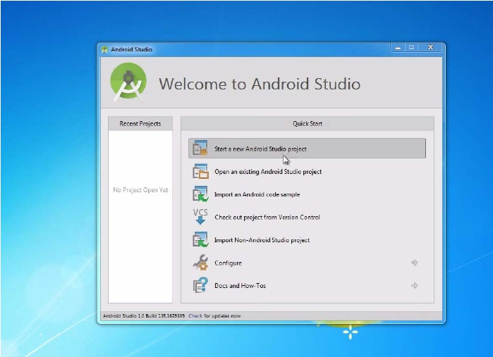
Start a new Android Project

Slide 26
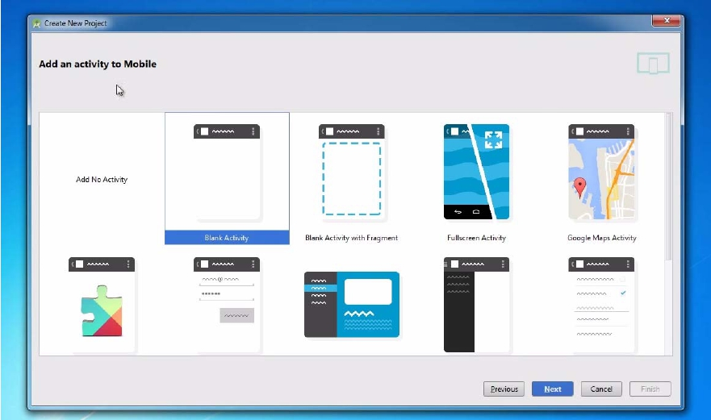
Add an Activity (Blank Activity is Simplest)

Slide 27
Running a Simple App
●
Tutorial 4: Android App Development for Beginners ‐ 4 –
Running a Simple App [10:48 mins] by Bucky Roberts
●
https://www.youtube.com/watch?v=qKRWC3Q8wRw
●
Main steps
●
●
●
●
Run Android Studio
Fix any remaining issues
Run AVD, select virtual device
Run App on selected virtual device

Slide 28
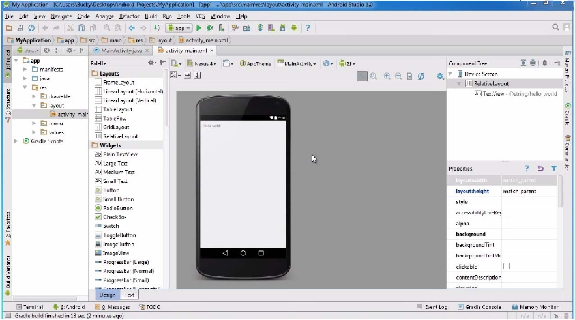
Open Android Studio

Slide 29
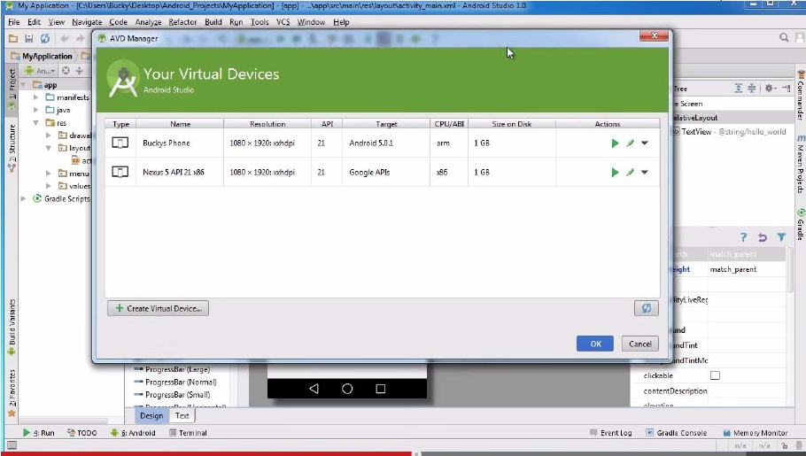
Run AVD Manager

Slide 30
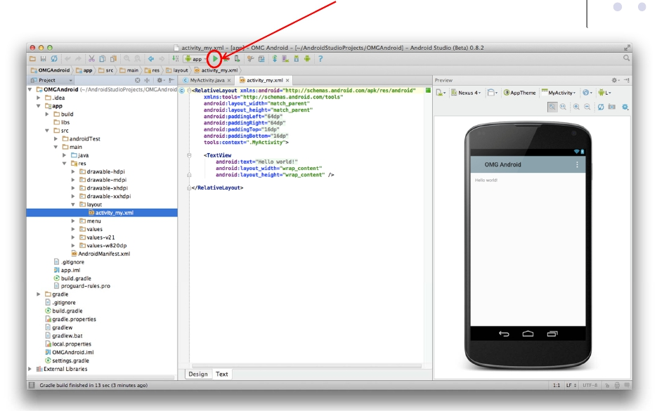
How to Run the App?
Click here to run the app

Slide 31
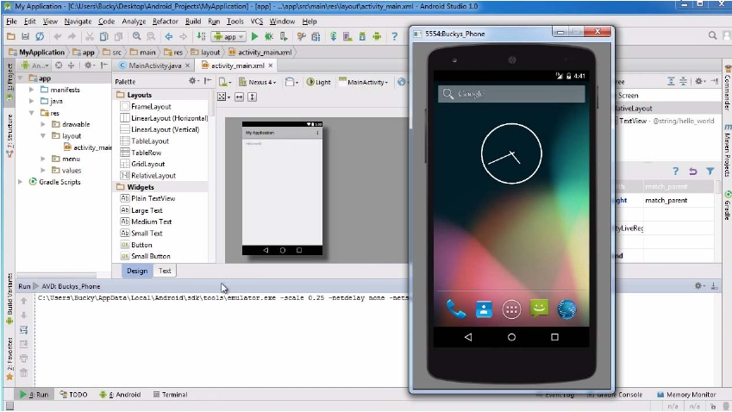
Run App on Virtual Device (Phone)

Slide 32
Tour of Android Studio Interface
●
Tutorial 5: Tour of Android Studio Interface [6:01 mins]
●
https://www.youtube.com/watch?v=‐pdTqBq2TFQ
●
Quick overview of main sections of Android Studio
●
●
●
●
●
Windows menu bar
Android tool bar
Project window
Editor Window
Palette for Drag‐and‐Drop Design of Android buttons
●
More detailed coverage of specific UI aspects later

Slide 33
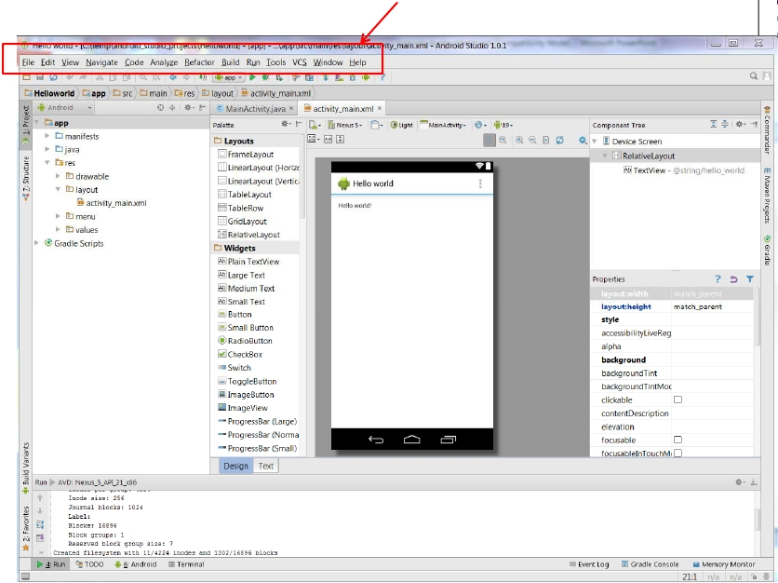
Typical Windows Menu Bar (File, edit, etc)

Slide 34
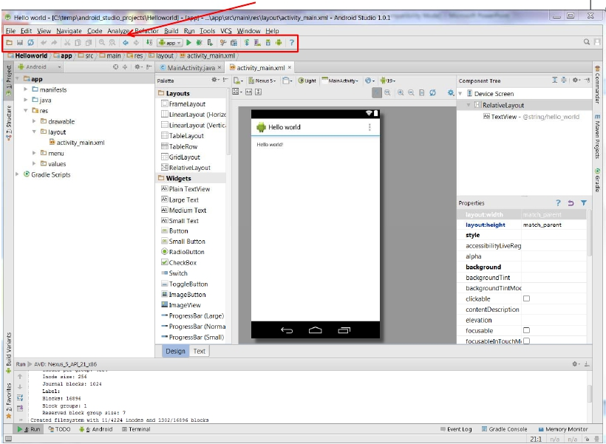
Tool Bar: Shortcuts to Frequently used Android-specific Functions
(E.g. One-click access to SDK manager)

Slide 35
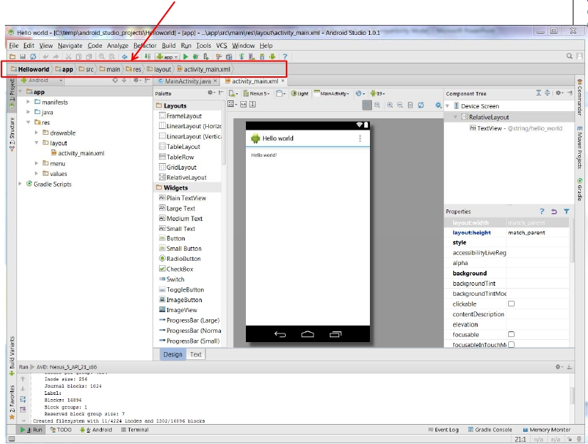
Path to Current File in IDE Window (Clickable)

Slide 36
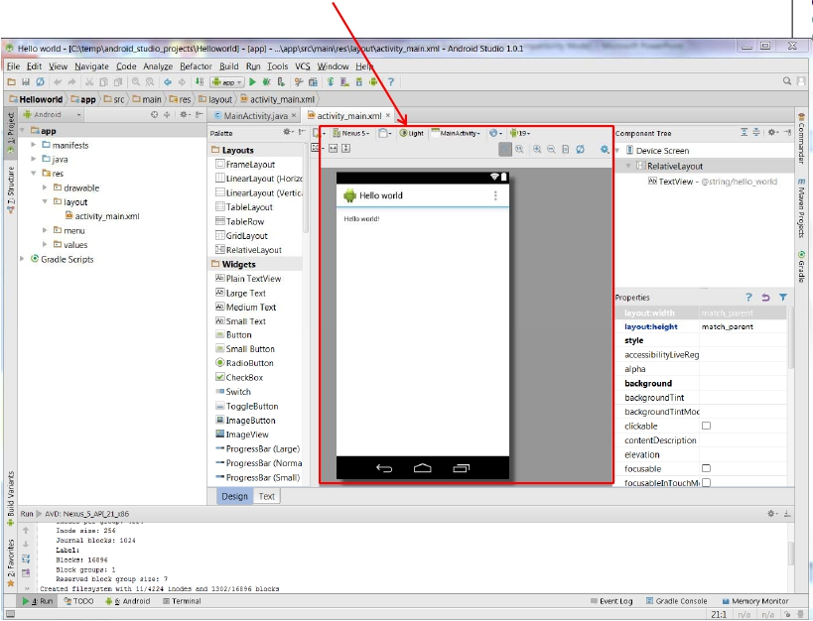
Editor Window (Allows editting of current file we are working on)

Slide 37
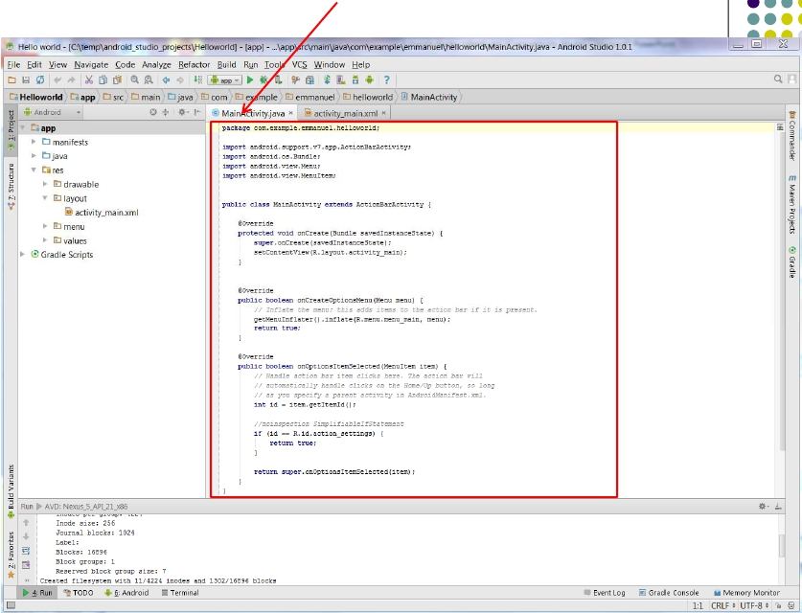
Clicking on Editor Window Tabs switches between Java code and Visual Interface

Slide 38
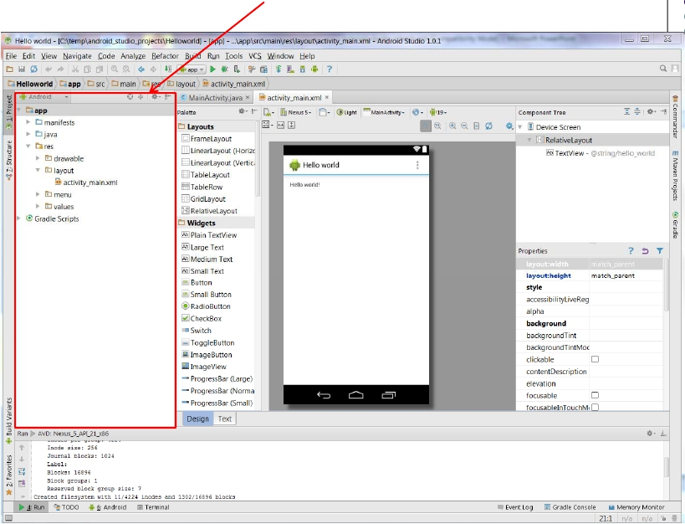
Project Window (Allows between project files, packages, etc)

Slide 39
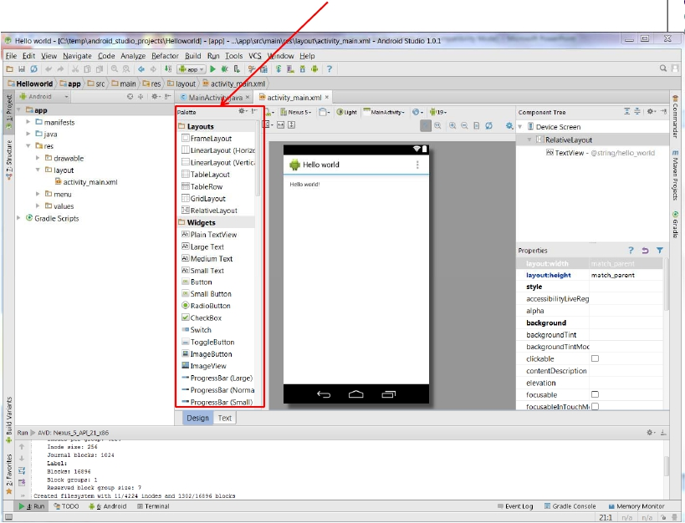
Palette of Drag-and-Drop Elements for Designing Interface (Layout, widgets, etc)

Slide 40
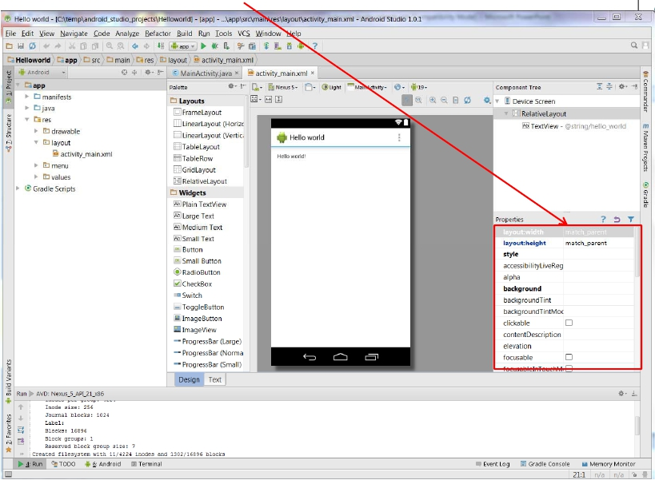
Parameters of Drag-and-Drop Elements for Designing Interface
(e.g. colors, dimensions of widgets, etc)

Slide 41
Importing Existing Code
●
●
●
●
Can also import existing code
The text comes with lots of free code you can learn from, use
in projects as starting point
Can import from gitHub repository
See tutorial #2 of busy coders book

Slide 42
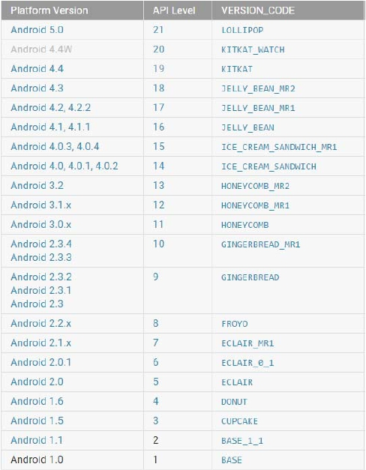
Android
Versions/API Levels

